Slide 1


Evaluation of edges readiness using masked graph autoencoders - MaskGAE
Project phase A
#24-1-R-10
Students:
Gilad Segal
Chen Hanzin
Supervisors:
Dr. Renata Avros
Prof. Zeev Volkovich

Slide 2
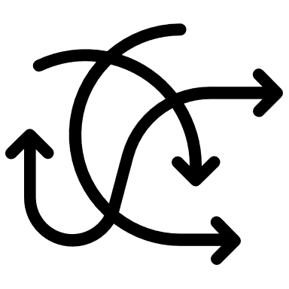

Introduction – The Problem
Complicated Process
current approaches of self-supervised learning largely depend on creating complicated extra steps or setup tasks, and on making many variations of the data to help the learning process.
Poor Performance
The current methods often struggle to capture the structural meaning of graph data, which can lead to non optimal performance and make the data learned from these methods not very useful in different real-world situations.

Slide 3


Introduction – The Solution
MaskGAE
Masked Graph Autoencoder is self-supervised learning framework (based on GAE) designed specifically for graph-structured data. It includes the principles of masking and prediction through node and edge-level reconstruction.
MGM
MaskGAE defines masked graph modeling (MGM) as a core component. This involves selectively masking parts of the graph (such as edges) and then training the model to reconstruct these missing parts from the remaining visible structure.

Slide 4
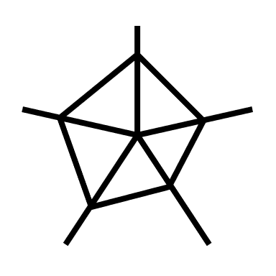

Background – Graph Autoencoders
GAE Intro
MaskGAE is based on Graph Autoencoders (GAE) which are a type of neural network model specifically designed to work with graphs. They use an encoder-decoder framework to learn how to reconstruct a graph from the input data. They mean to learn meaningful representations of nodes or entire graphs that capture the essence of the original graph structure.
GAE Flaw
While effective in many scenarios, traditional GAEs have limitations, particularly their tendency to over-emphasize immediate node connections (local information). This focus can lead to a loss of broader structural information, which is important for understanding complex patterns of the graph.

Slide 5

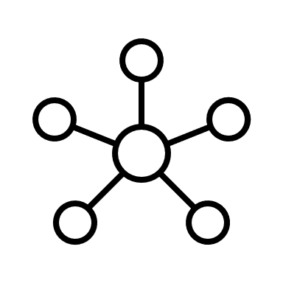
Background – Contrastive Learning
Learning Technique
Contrastive Learning is a powerful unsupervised learning technique used to enhance the ability of models to understand and distinguish data by comparing contrasting examples.
This method helps in maximizing the mutual information between various representations of the data.
In Graphs
In graphs, contrastive learning is adapted to handle networks of nodes and edges. This is done by creating multiple versions of the same graph, each slightly altered or viewed from different perspective.
The goal is for the model to learn these different versions and thus learn similar or different structural patterns of the graph.
Notes:
Contrastive Learning: It involves learning to distinguish between similar (positive) and dissimilar (negative) pairs of data points, enhancing the model’s ability to recognize subtle differences and similarities.
We can give an example of citation networks and examples for properties in this network

Slide 6
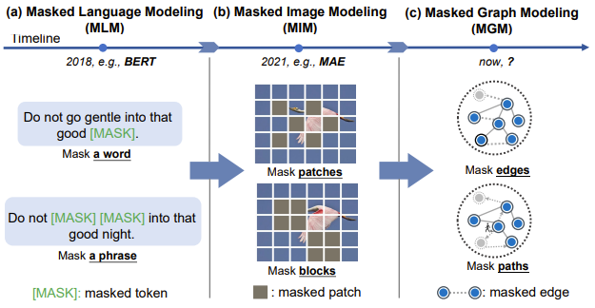
Background – Masking
Current Masking Approaches
Masking techniques are known mostly in tasks related to natural language processing and image processing, where models learn to fill in the gaps in text or images.
These approaches were the inspiration to create a similar technique suitable for graphs (MGM).
Notes:
To talk about the image: in text, the model reconstructs the sentences (hidden words) by learning semantics of the text.
Also to in images to talk about hidden pixels, or patches…

Slide 7
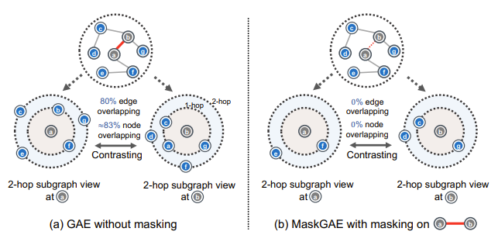
Background – Masking
Masking Advantages
Masking in graphs encourages the model to develop a deeper understanding of the graph’s overall architecture, beyond just the visible connections.
In addition, masking requiring the model to consider broader graph contexts by lowering the redundant information that traditional GAEs can sometimes focus on.
Notes:
For instance, consider an edge (a, b) which is identified as a positive connection. By removing this edge, the resulting subgraphs focused on nodes a and b respectively will exhibit reduced overlap, with fewer common nodes and edges. This reduction in overlap helps in diversifying the information captured by the model, enhancing its ability to learn more distinct and useful representations that are important for the tasks at hand. The MaskGAE model leverages this approach to effectively minimize redundancy, offering a more refined and potentially more accurate graph analysis tool compared to standard GAE.

Slide 8
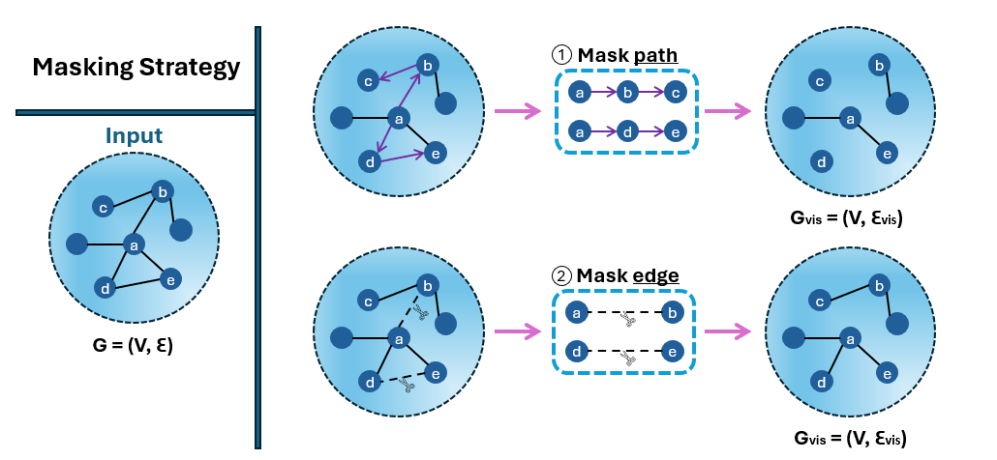
MaskGAE Model – Masking Strategy
Notes:
Describe the Masking Strategy image: two strategies and how they work. The next slide is more formal way of explaining

Slide 9


MaskGAE Model – Masking Strategy
1
Edge-wise Random Masking
This strategy involves randomly selecting a subset of edges based on a Bernoulli distribution, providing a simple way to mask the graph.
p<1 is the masking ratio for the graph.
2
Path-wise Random Masking
Path-wise masking uses paths in the graph as building blocks. They sample a set of starting nodes and then use a coin flip (Bernoulli distribution) to choose which of them will be the starting node for a series of masked nodes, using “simple random walk” to decide which edges on the path to mask.
R is the set of statring nodes and I is the path lengh.

Slide 10
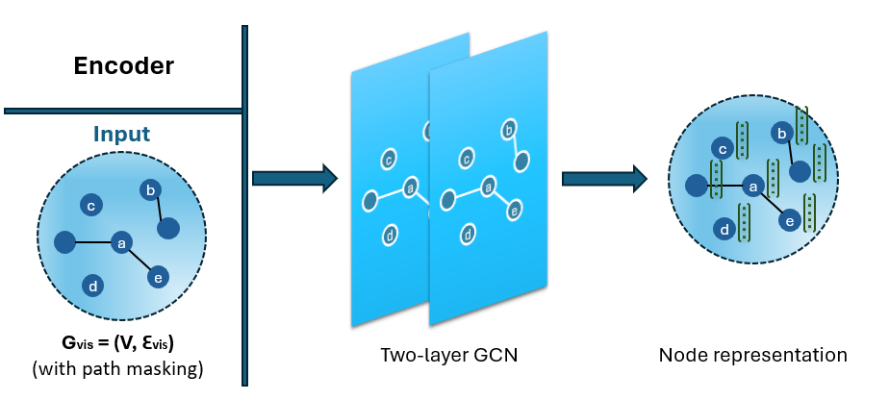
MaskGAE Model – Encoder
Notes:
Here we want to talk about encoder’s purpose: the encoder is basically two GCN layers (type of GNN) which maps the nodes into more organized vectors of information that will fit the learning process

Slide 11
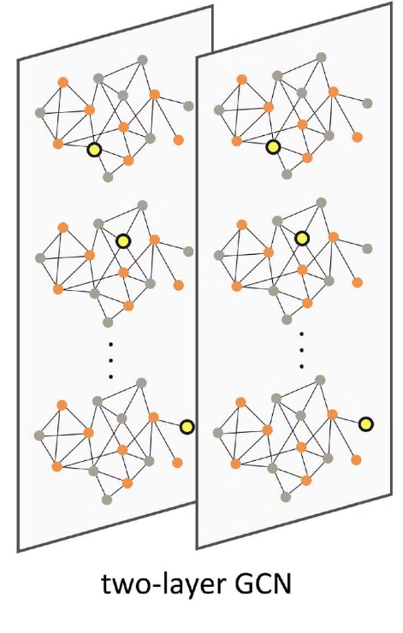
MaskGAE Model – Encoder
The encoder receives as input the visible, unmasked sub-graph and it views the graph in small pieces at a time. It maps the nodes to low dimensional representations (embedings) for the decoder.
The embeddings learned by the encoder are extracted for each node in the test set. These embeddings serve as input features for a linear classifier, such as logistic regression. The linear classifier is trained using the embeddings of the labeled nodes in the training set.
The encoder is a specific type of neural network architecture called Graph Convolutional Networks (GCN) that is a kind of GNN (Graph Neural Network) architecture.

Slide 12
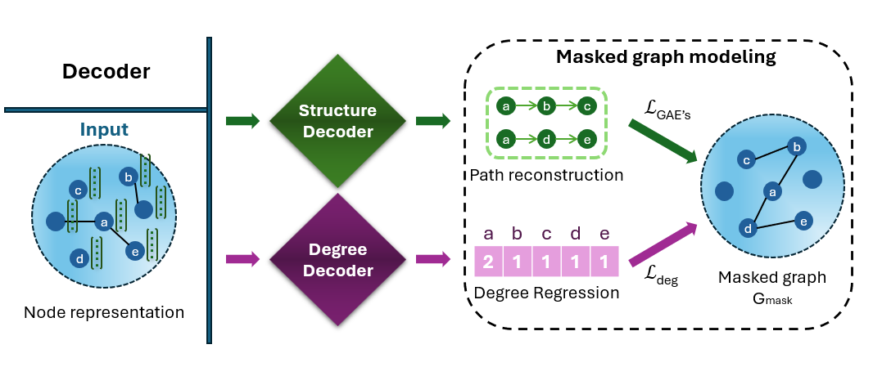
MaskGAE Model – Decoder

Slide 13

MaskGAE Model – Decoder
Structure
Decoder
Degree
Decoder
$$h_{ω}(z_{u} ,z_{v})=Sigmoid(MLP\left(z_{u}◦z_{v}\right))$$
$$g_{ᶲ}(z_{v})=MLP\left( z_{v}\right)$$
'Zu' and 'Zv’: features vectors for nodes 'u' and 'v'.
The Structure Decoder performs element-wize product of the vectors, and the result is transferred to MLP.
The MLP (multilayer perceptron) is a type of neural network that learns complex patterns and relationships.
The output form the MLP is then transferred to the Sigmoid function as input for binary classification of link connection between every two nodes.
ℎ𝜔 (𝑧𝑢, 𝑧𝑣 ): This is the final output, representing the predicted link between nodes 𝑢 and 𝑣. The Sigmoid function is applied to the result of the MLP, providing the likelihood or strength of the connection between nodes 𝑢 and 𝑣.
Responsible for understanding the number of connections each node has. This forces the model to approximate the node degree to facilitate the training.
For the degree decoder there is only use of MLP to generate the number of neighbors for each node.

Slide 14



MaskGAE Model – Learning Objective
The combined objective of MaskGAE is to find a balance between reconstructing the masked graph's edges (Reconstruction Loss) and accurately predicting node degrees (Regression Loss). The parameter 𝛼 controls the trade-off between these two terms and influences the regularization aspect of the learning.
Reconstruction Loss ( )
The reconstruction loss evaluates how well the model reconstructs the masked graph, specifically focusing on the edges that were masked.
Regression Loss ( )
The regression loss assesses how accurately the model predicts the node degrees in the masked graph.
$$ℒ$$
GAE’s
$$ℒ$$
deg
Loss Regression contributes to the regularization, i.e., guides the model to learn more abstract representations that are beneficial for tasks beyond the training data. This helps prevent overfitting of the model and enhances its ability to handle a variety of graph structures effectively.
$${ℒ=ℒ}_{GAEs}+ αℒ_{deg}$$

Slide 15
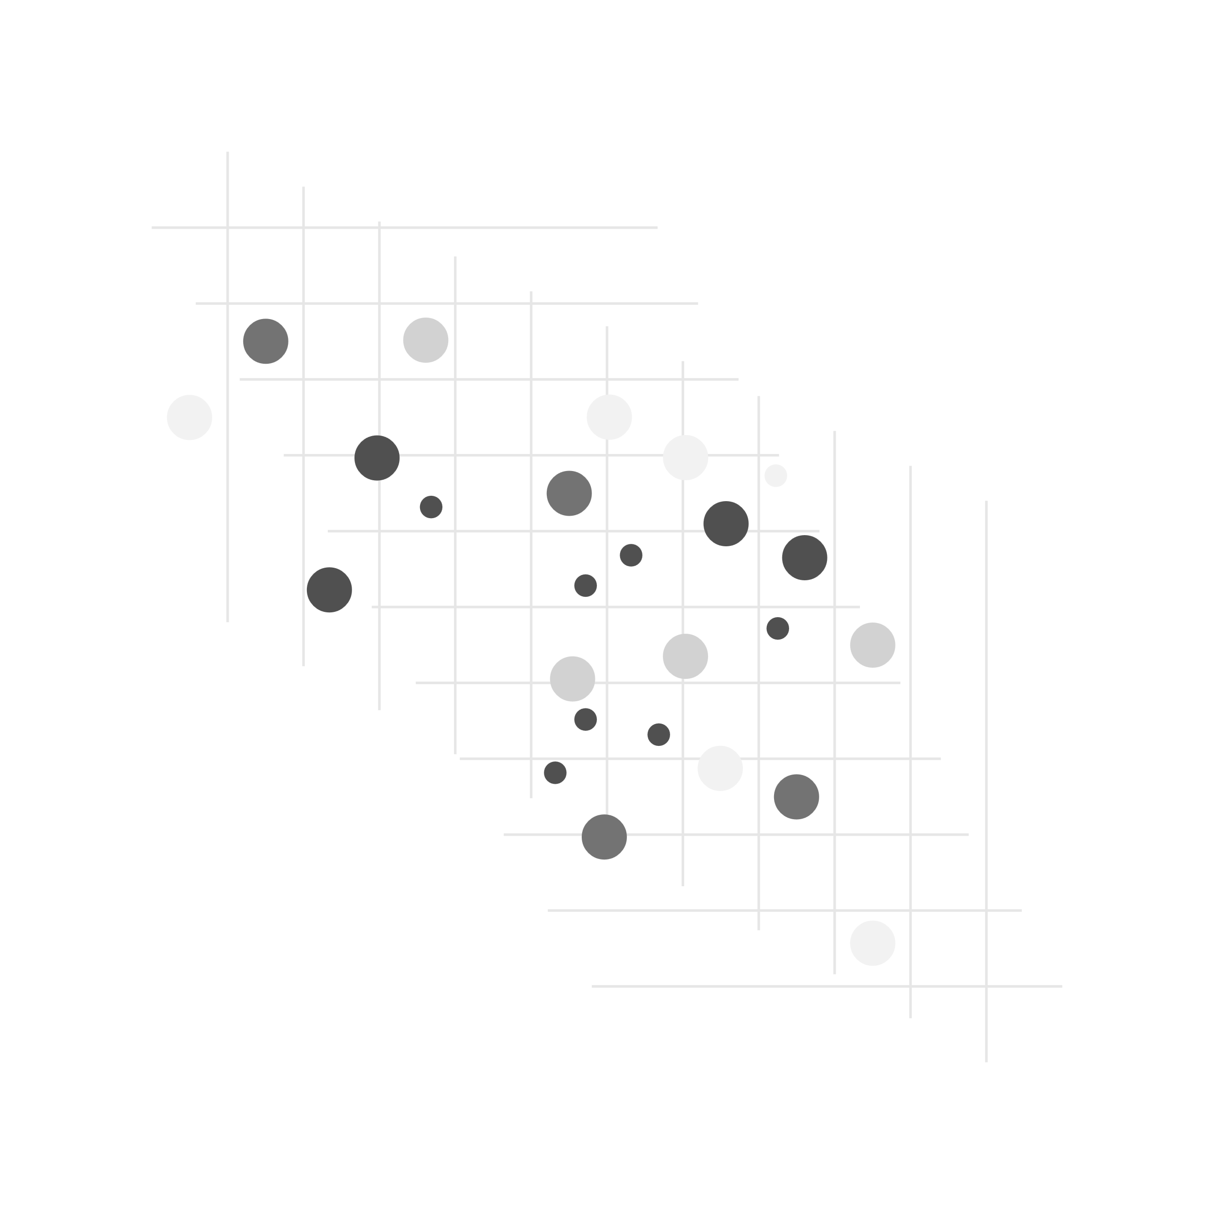
Expected Achievements
The anticipated goals of this project involve creating a smart learning model that can improve self-learning for graphs.
The model's main goal is to develop a new algorithm called MaskGAE, designed to mitigate issues associated with data redundancy. We're going to check how effective the model is at rebuilding hidden connections in the graph.
We will mask connections and see if the model can find them correctly. This will help us see how well the model understands the graph.

Slide 16
Evaluation Plan
To effectively evaluate the performance of the MaskGAE model, we will perform two primary tasks: Link Prediction and Node Classification.
Each task will have specific setups for sampling, training, and evaluation metrics.

Slide 17
Evaluation Plan – Link Prediction
Setup and Sampling: We will prepare the data for the link prediction task, by sampling 10% of existing edges from each dataset to serve as positive examples. An equal number of non-existent edges (unconnected node pairs) will also be sampled to serve as negative examples, ensuring a balanced dataset for testing.
Model Training: The model will be trained through iterations over mini-batches of these masked edges, where the primary objective is to predict whether a link (edge) should exist between pairs of nodes. The training will use cross-entropy loss to evaluate the accuracy of the edge predictions.
Optimization: Gradient-based optimization algorithms, such as Stochastic Gradient Descent (SGD) or Adam, will be used to adjust the model parameters. This process continues iteratively until convergence.
Evaluation Metrics: Our metrics for evaluation regarding this task are ROC AUC Score and Average Precision Score.
Notes:
ROC AUC Score will measure the model's ability to distinguish between the classes of linked and non-linked node pairs over the graph network. Average Precision Score reflects the model's ability to correctly identify positive (actual linked) pairs of nodes in the network.

Slide 18
Evaluation Plan – Node Classification
Setup and Training: We start by training the model with a graph. We set specific tasks for the model (pretext tasks) that guide it to focus on learning which features of nodes are important. These tasks are not the main goal but help the model get better at the main task of classifying nodes.
Feature Combination: After the initial training, the model produces outputs at different stages of the process. We take these outputs and combine them all together to create a full representation of each node. This combined information is more detailed because it includes conclusions from various levels of the model’s processing.
Model Evaluation: We use logistic regression model to check how well our node features (that were learned from the model) can predict node classes. We ensure that these features (embeddings) we are testing are not changed anymore by the logistic regression model. This means no changes happens at this point in the main model. This step helps us understand how useful and accurate the learned features are for classifying nodes, without making any more adjustments to how they are learned.
Evaluation Metrics: Our metrics for evaluation regarding this task are Accuracy and Precision.
Notes:
Accuracy: This metric will measure the percentage of correctly predicted labels over the total number of nodes in the test set. It provides a straightforward indicator of the model's overall effectiveness in correctly classifying nodes.
Precision: This will assess the proportion of positive identifications that were actually correct, particularly important in situations where the cost of a false positive is high. It helps in understanding the reliability of the predictions in terms of class-specific performance.

Slide 19
Test Plan
Data Preparation
Split dataset into training and testing sets.
Ensure testing set represents both relevant and irrelevant citations.
Model Training
Train the model on training set data.
Input features and labels indicate citation relevance.
Prediction Generation
Apply trained model to testing set.
The model predicts relevance of each citation in the network.
Notes:
Accuracy: This metric will measure the percentage of correctly predicted labels over the total number of nodes in the test set. It provides a straightforward indicator of the model's overall effectiveness in correctly classifying nodes.
Precision: This will assess the proportion of positive identifications that were actually correct, particularly important in situations where the cost of a false positive is high. It helps in understanding the reliability of the predictions in terms of class-specific performance.

Slide 20
Test Plan
Evaluation Metrics
Calculate accuracy, precision, and other metrics.
Compare model predictions with actual data.
Interpretation and Analysis
Assess model performance based on metrics.
Evaluate model's accuracy and effectiveness.
Fine-tuning and Iteration
Adjust parameters and features based on performance.
Repeat iteration of training/testing to improve outcomes.
Notes:
Accuracy: This metric will measure the percentage of correctly predicted labels over the total number of nodes in the test set. It provides a straightforward indicator of the model's overall effectiveness in correctly classifying nodes.
Precision: This will assess the proportion of positive identifications that were actually correct, particularly important in situations where the cost of a false positive is high. It helps in understanding the reliability of the predictions in terms of class-specific performance.

Slide 21

Thanks for listening

